Slide 1






Part of the AgentCon World Tour by the Global AI Community
AI Agents Developer Conference
agentcon.city/hong-kong

Slide 2







Made Possible by

Slide 3
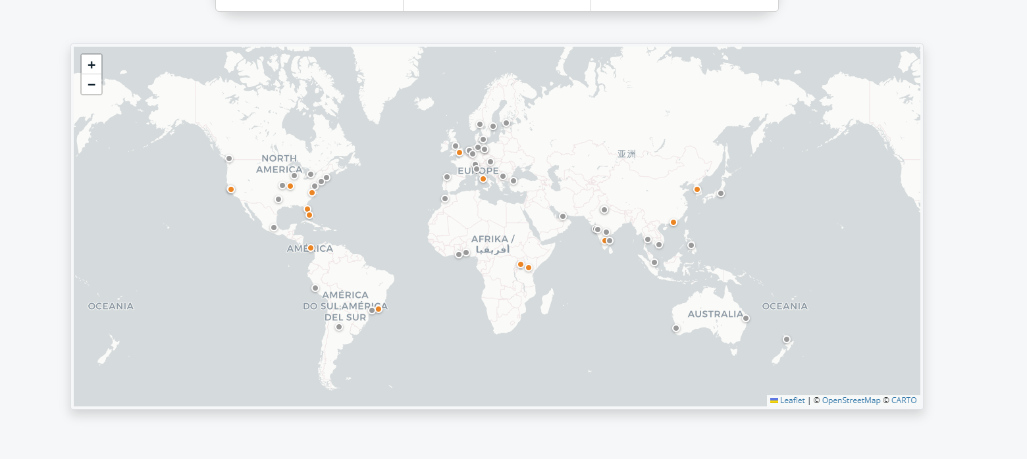
36
62
437
Locations
Hours of content
Countries

Slide 4



Code of Conduct
Be Respectful &
Considerate
Show Empathy &
Kindness
Foster
Collaboration
globalai.community/about/code-of-conduct/

Slide 5

Join the AI Conversation on Discord
gaic.io/discord

Slide 6
10:00 AM
10:30 AM
Welcome Note
Dux and Dr. Eric
Keynote
Henk Boelman, Dona Sarkar, Dux Raymond Sy, Ankur Sharma
10:30 AM
11:30 AM
Lecture Theatre 5
English
Lecture Theatre 2
Cantonese
Cybersecurity
Ctr 412, 413
Computer Room
511
01:00 PM – 01:30 PM
Lunch
01:30 PM – 03:30 PM
Sessions
03:00 PM – 04:00 PM
Break
04:00 PM – 04:30 PM
Sessions
05:00 PM
Raffle and Closing

Slide 7
Your feedback matters
Add feedback QR code here

